Slide 1

Confidence Dissociation in Humans & Neural Networks
12-2021

Slide 2
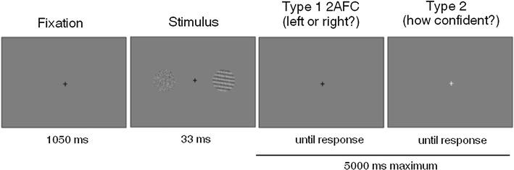
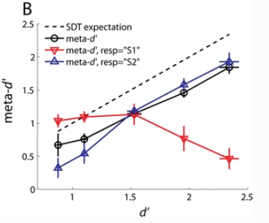
The Motivation: Confidence / Accuracy Dissociation
Experiment: which side contained the grating?
S1 stimulus: Constant contrast for grating on one side of screen
S2 stimulus: Varied contrast (5) on the other side
Maniscalco, Peters & Lau, 2016

Slide 3
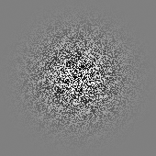
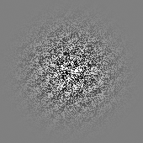
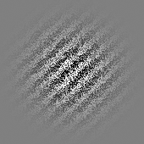
Our Experiment
Clockwise or counterclockwise from 45 degrees?
Decision?
fixate
3 tilts for behavioral, 6 for model
little, medium, a lot
3 contrasts for both
0.35, 0.45, 1
Pictured: medium tilt, all contrasts

Slide 4
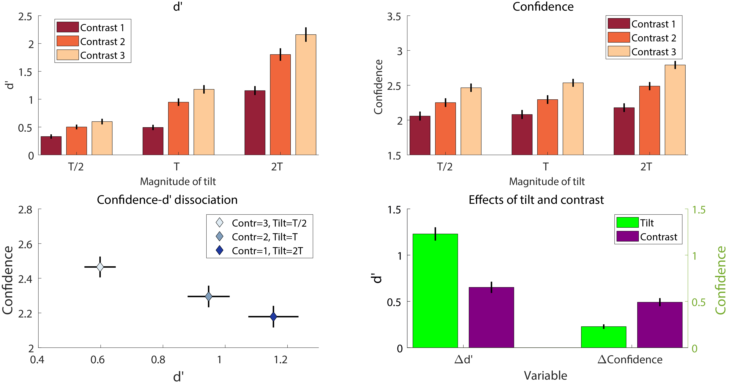
Behavioral Results

Slide 5
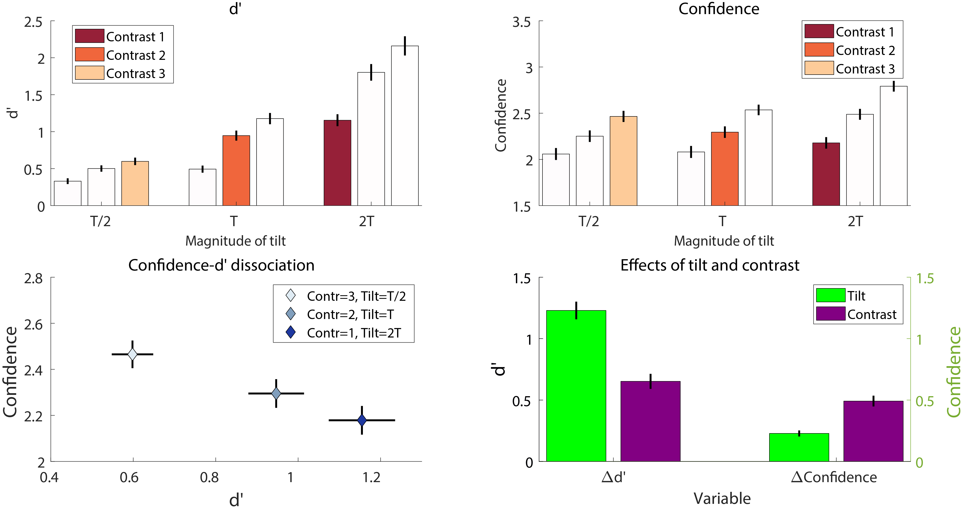
Behavioral Results

Slide 6
Model Choice: Transfer Learning
Transfer knowledge from one domain to another
ie: trained weights in a particular neural network architecture
Transfer object recognition knowledge to Gabor discrimination task

Slide 7
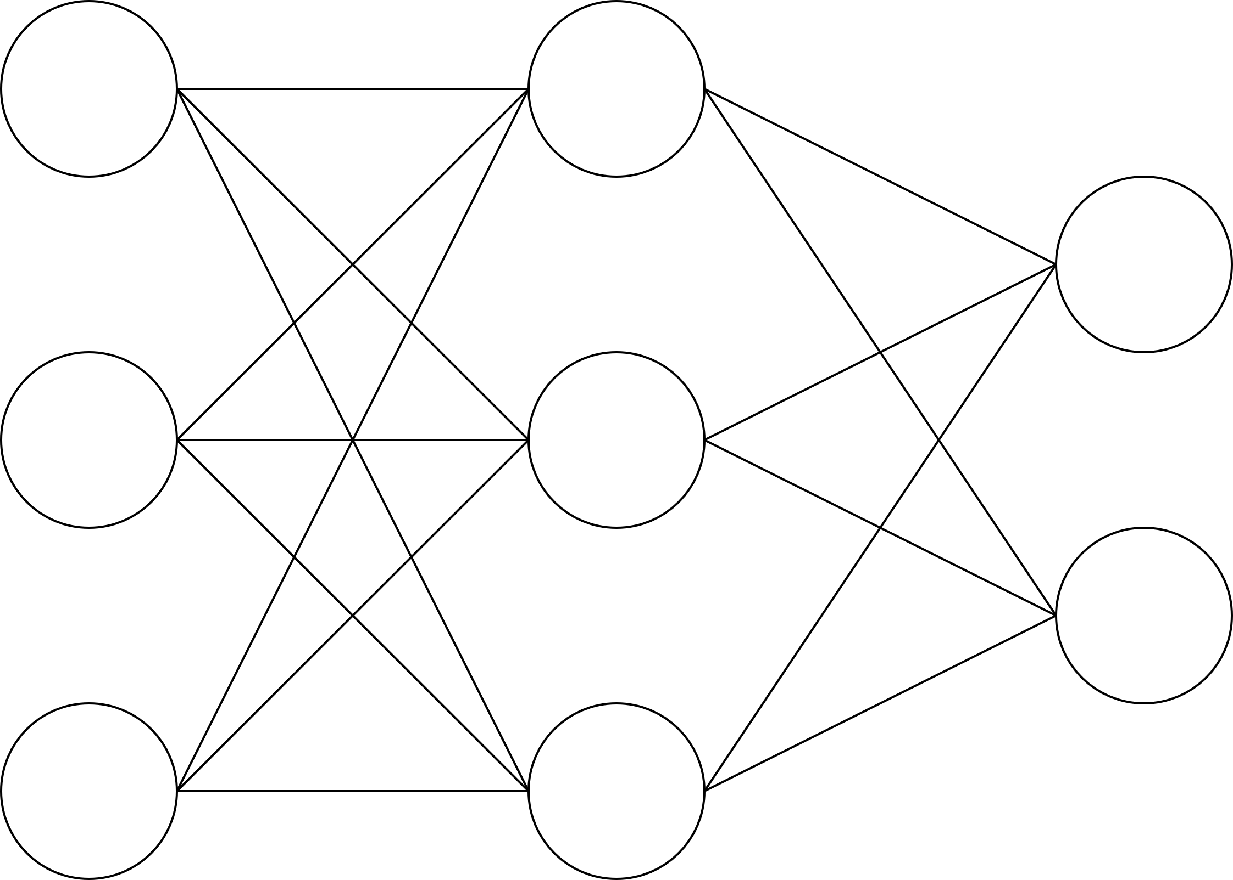
Transfer Learning
Step 1: Setup architecture
input
hidden
output

Slide 8
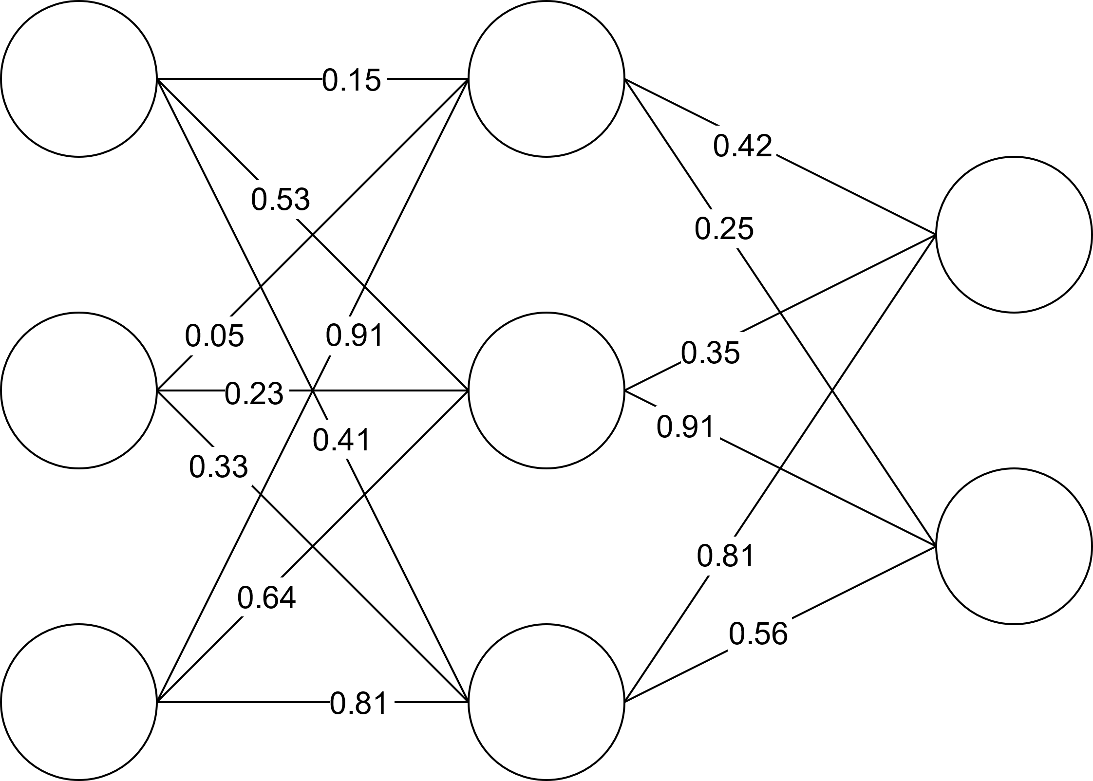
Transfer Learning
Step 2: Train weights on dataset (ie: Imagenet)
input
hidden
output

Slide 9
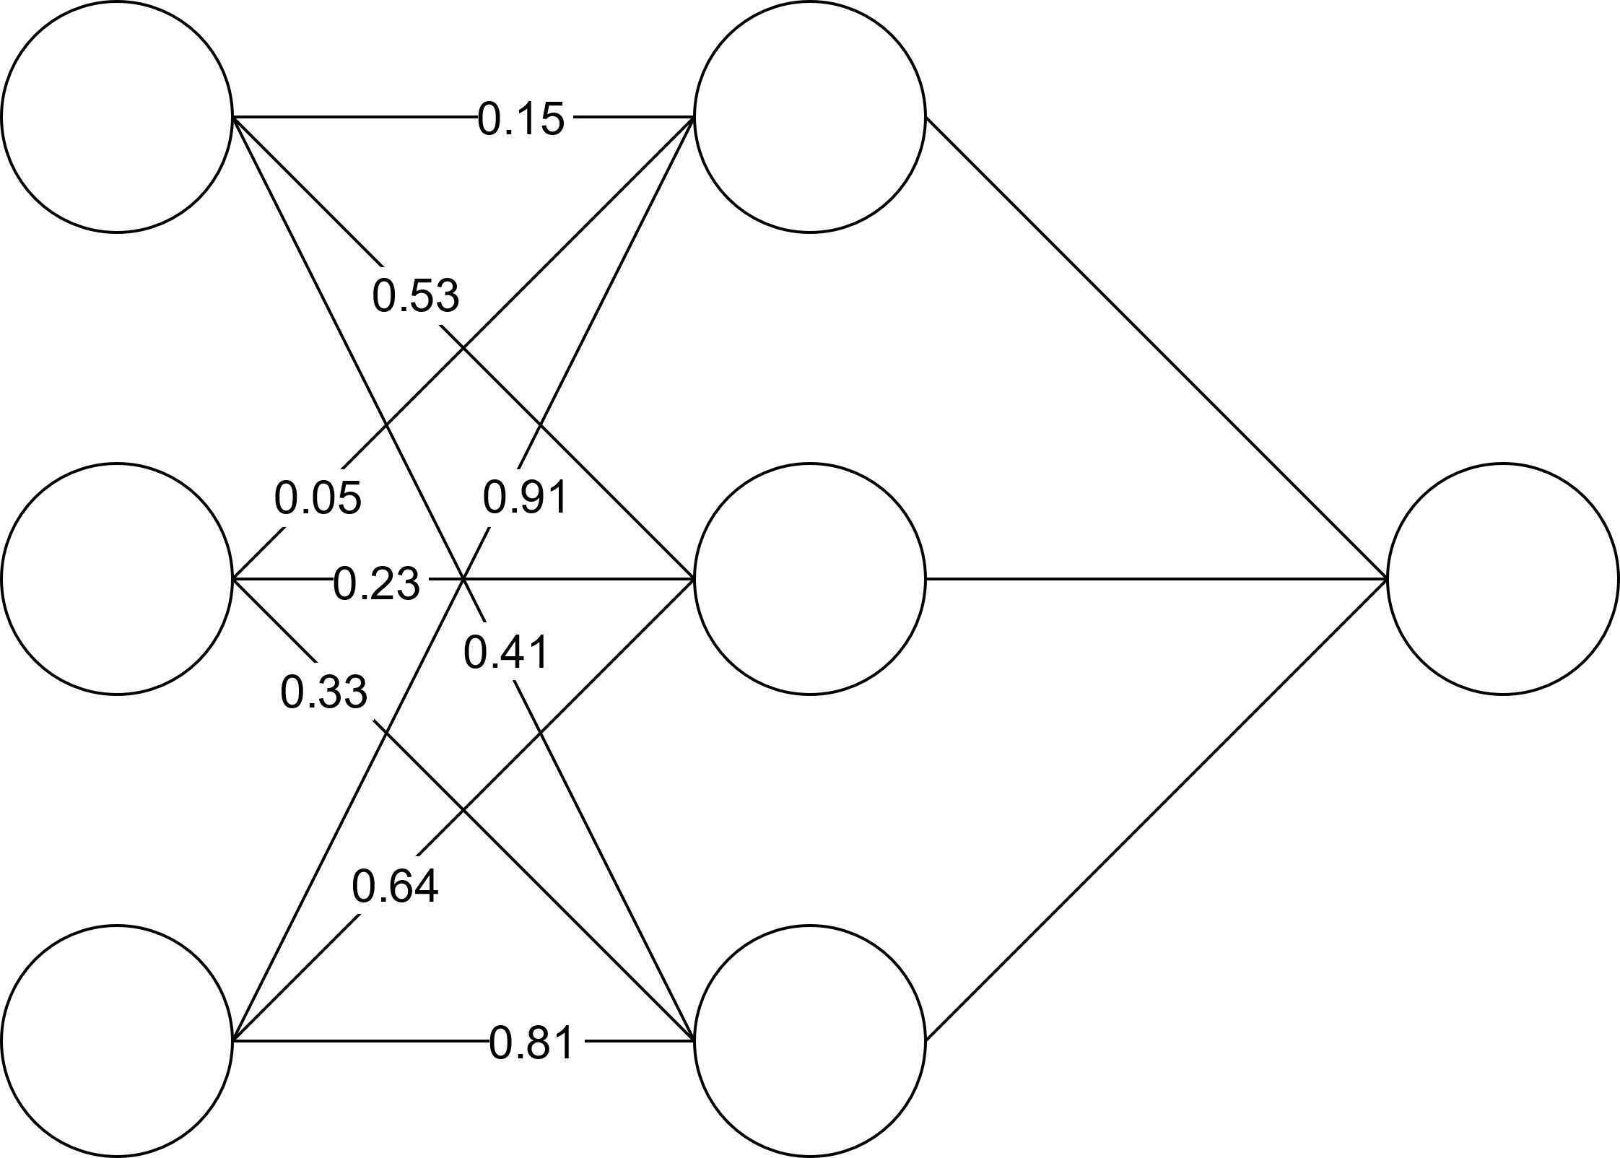
Transfer Learning
Step 3: Freeze learned weights and replace last layer
input
hidden
output

Slide 10
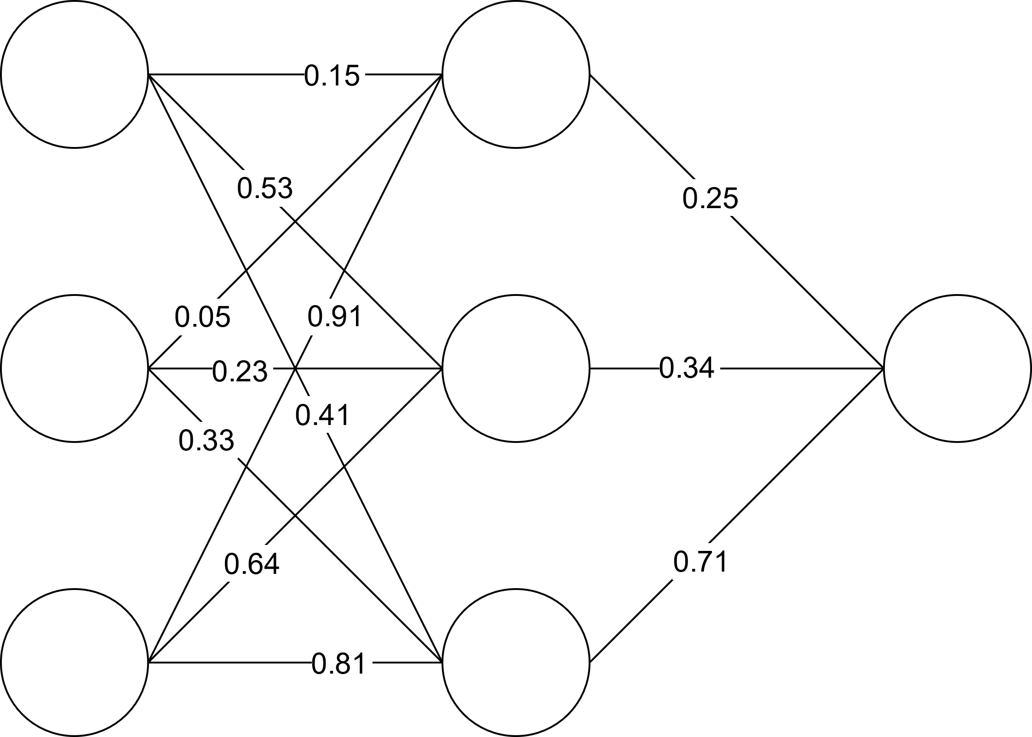
Transfer Learning
Step 4: Train weights between last layer on dataset from new domain (ie: Gabors)
input
hidden
output

Slide 11
Transfer Learning
MobileNetV2 (Sandler et al., 2018)
Base layers trained on Imagenet
VGG16 (Simonyan & Zisserman, 2014)
Base layers trained on Imagenet
Vanilla CNN
Base layers trained on CIFAR10
All are object-recognition networks
Meant to model visual system to varying degrees

Slide 12
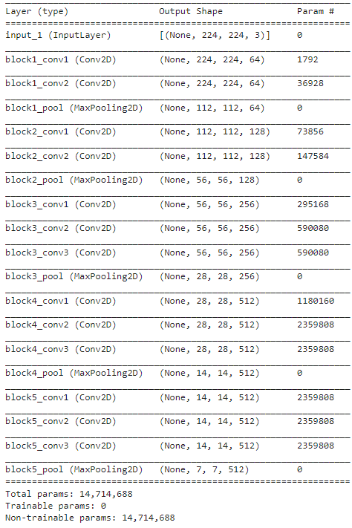
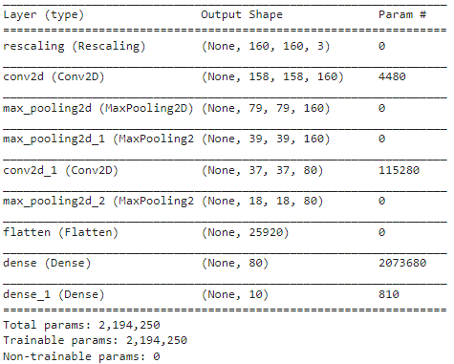
Model Details
VGG 16
Vanilla CNN

Slide 13
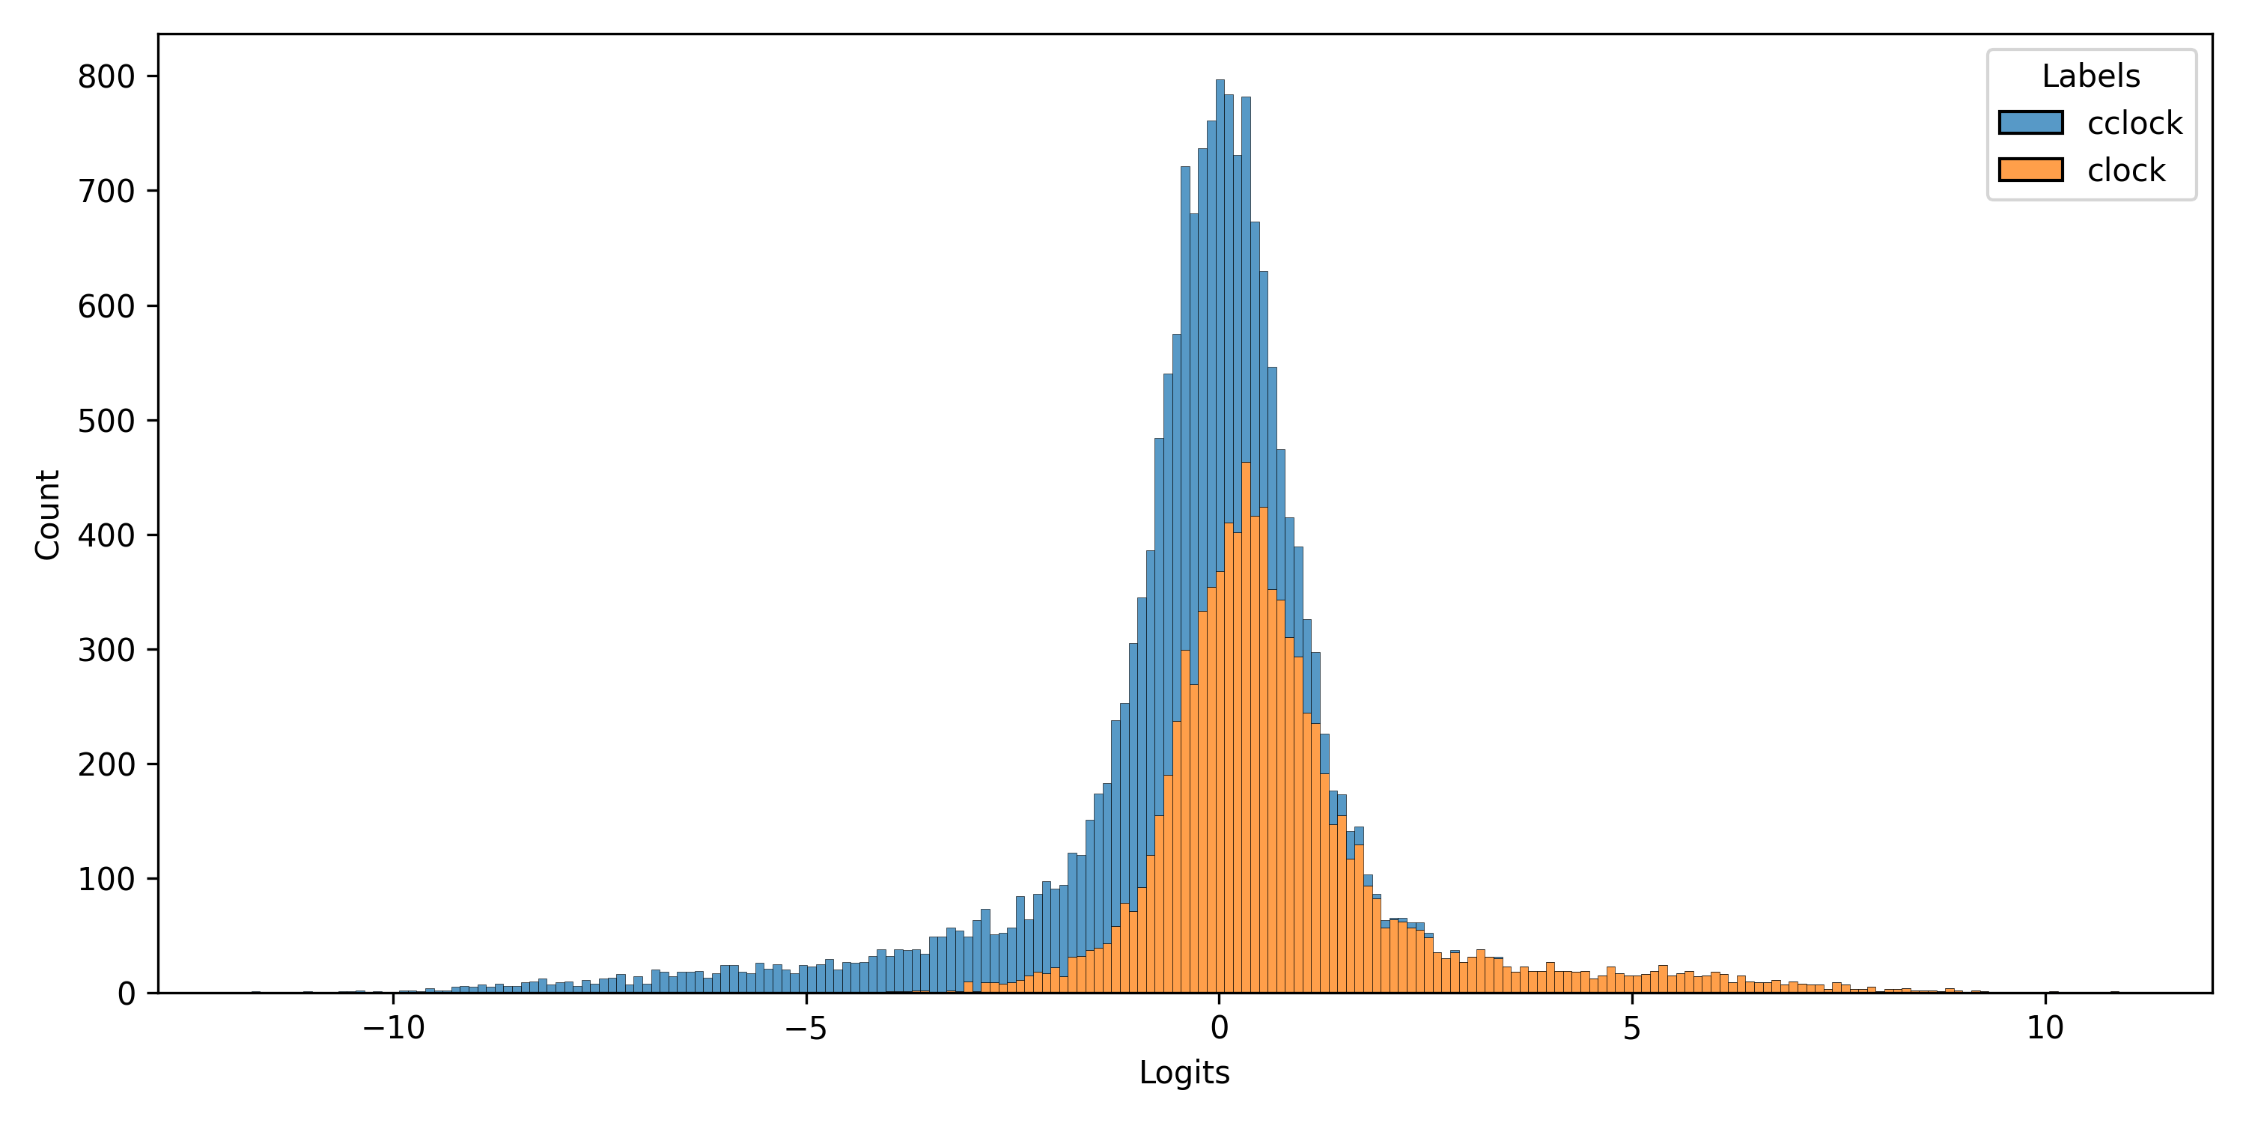
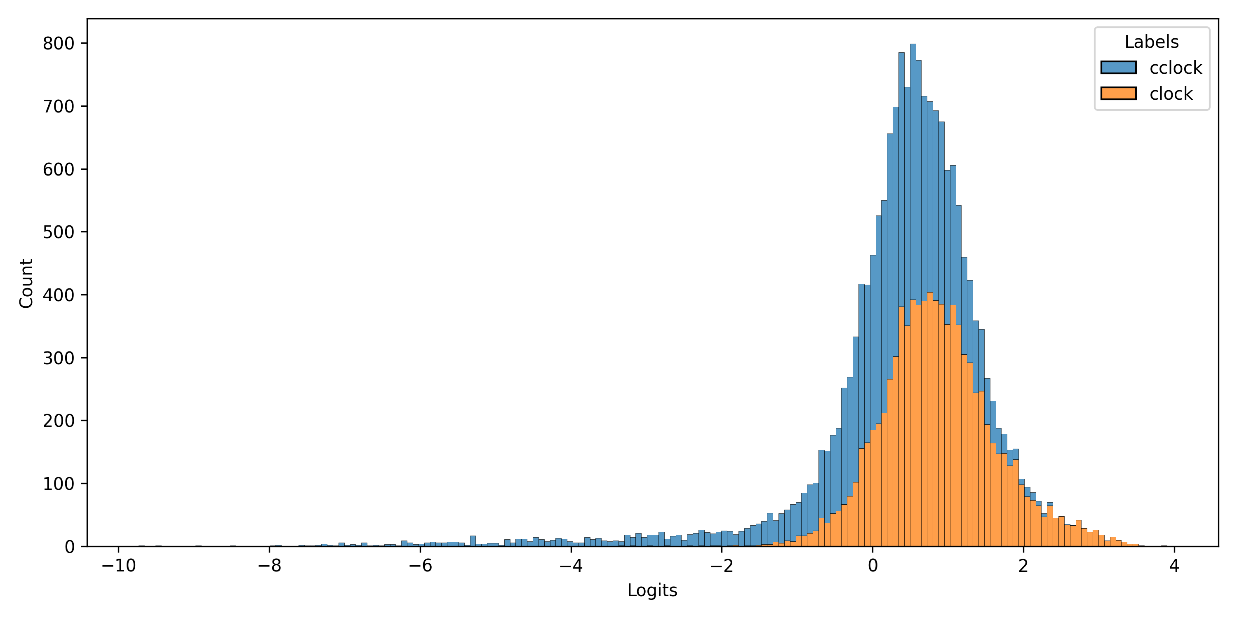
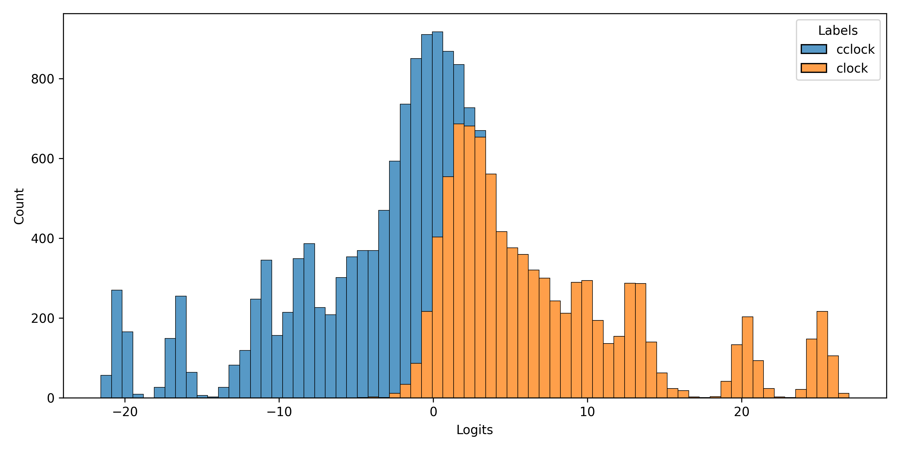
Model Prediction Distributions
VGG16
CIFAR10 (Vanilla)
Gabors (Vanilla)

Slide 14
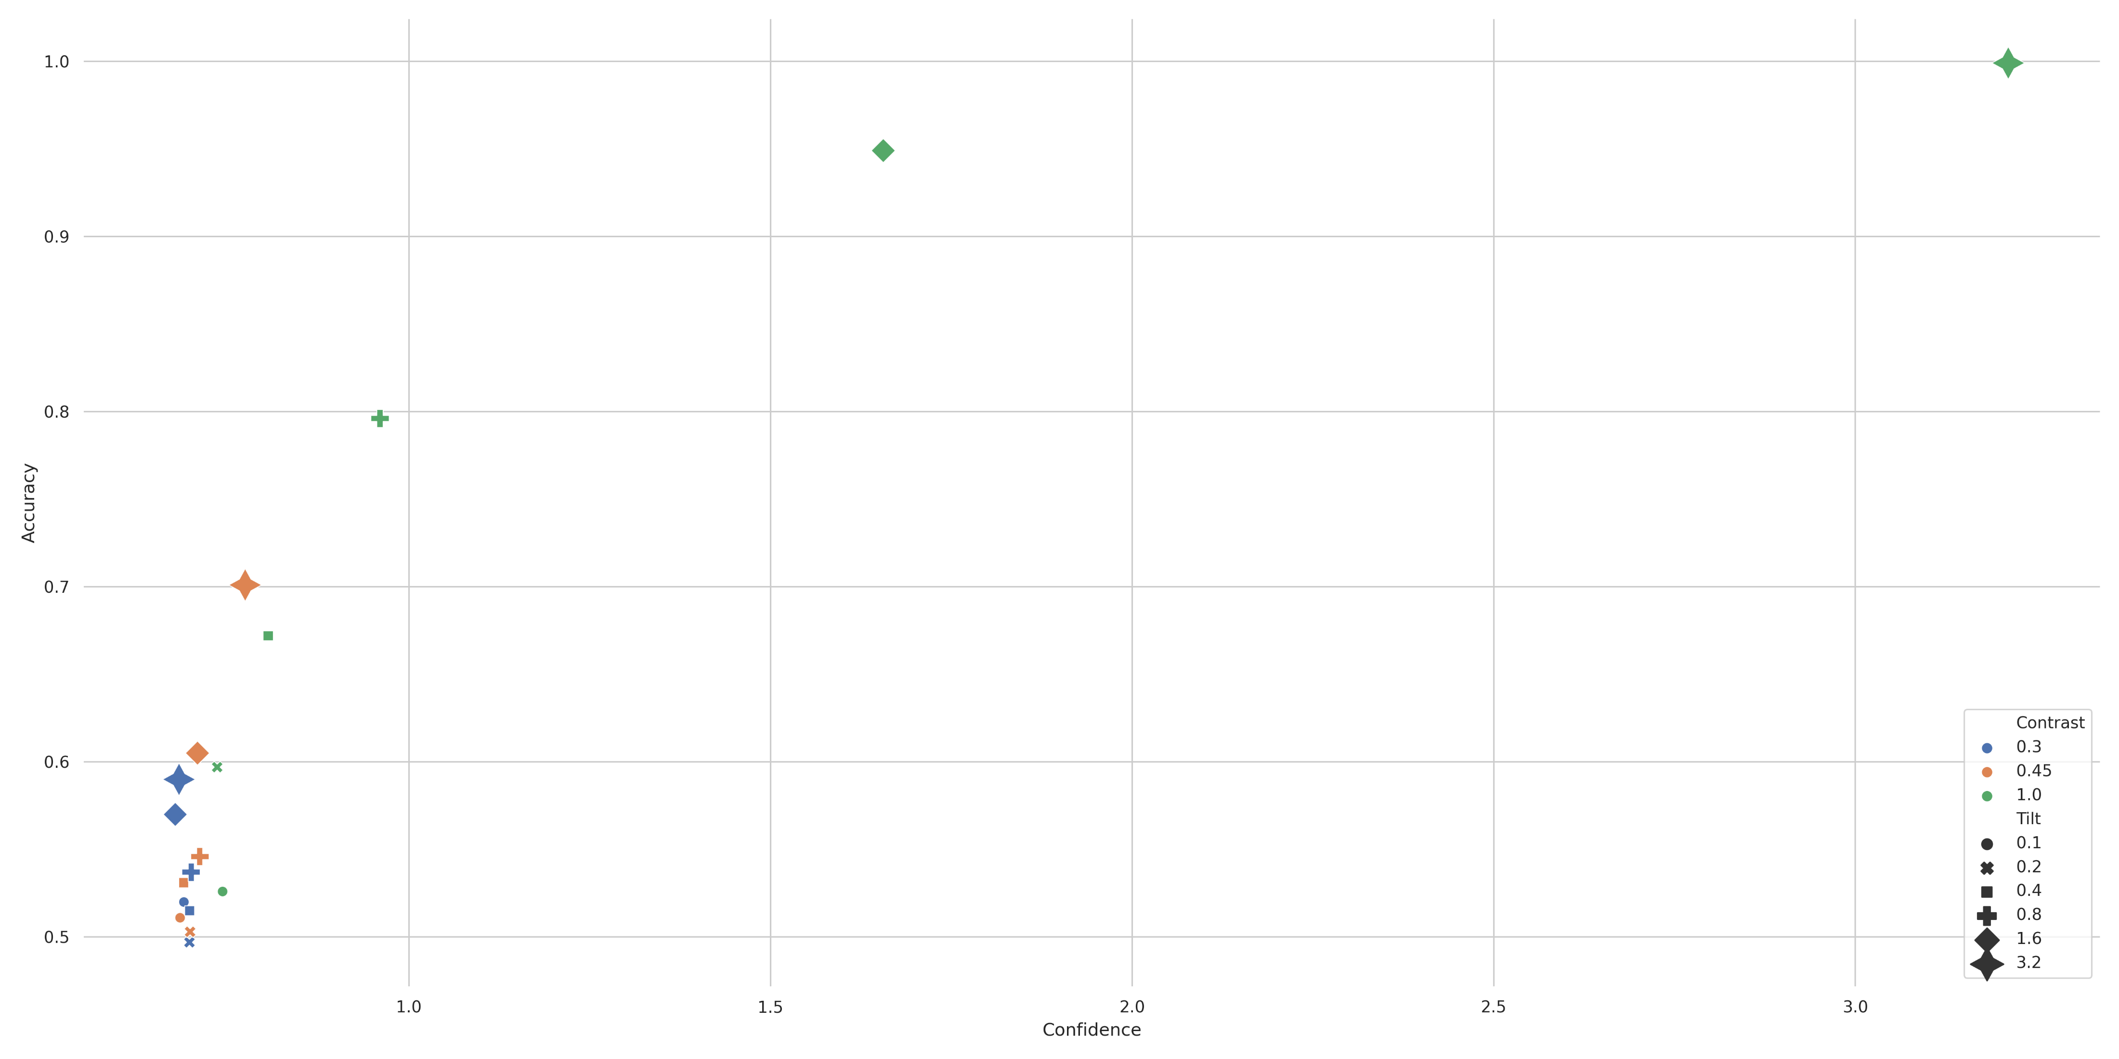
CIFAR10 Results (Vanilla) * Multiple Dissociations*

Slide 15
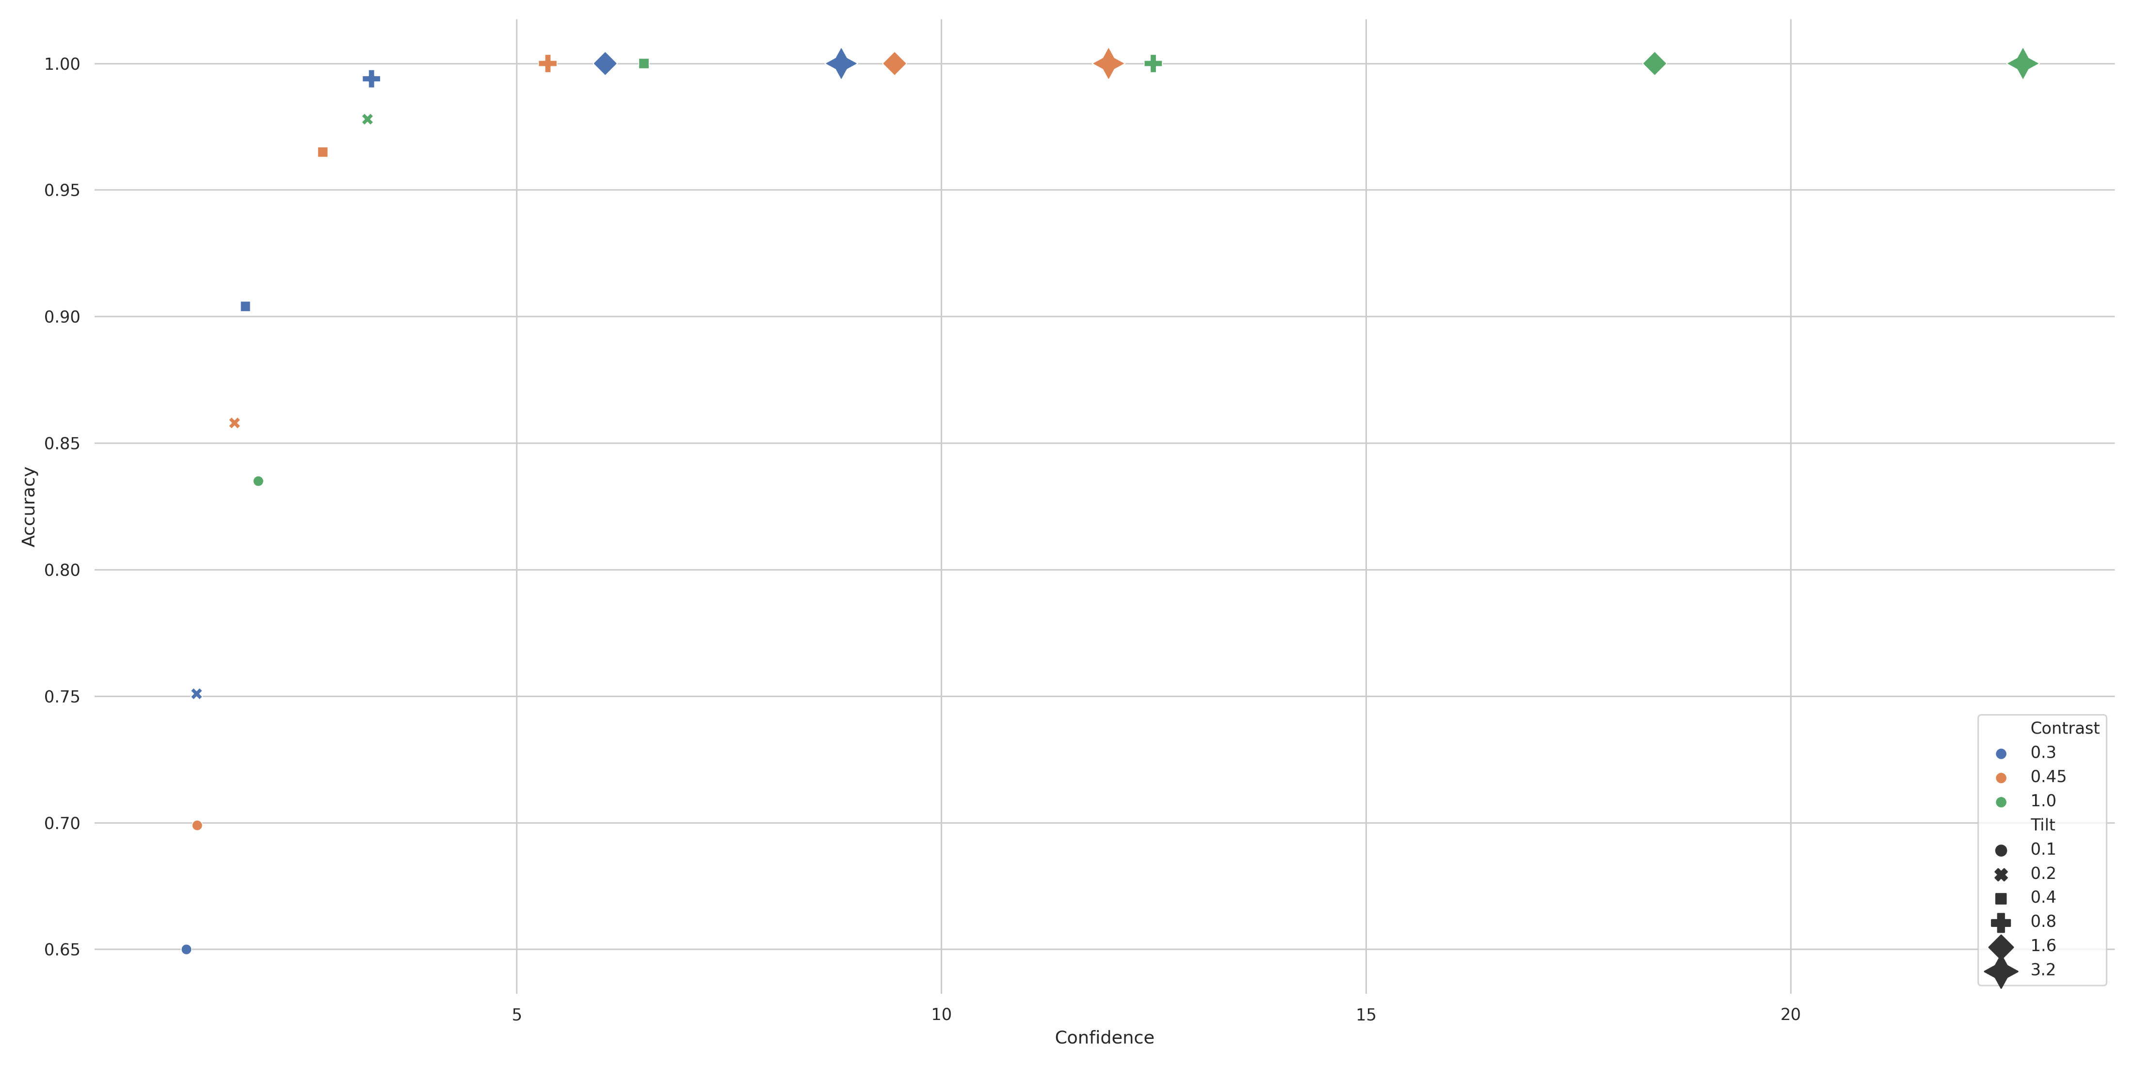
Gabor Results (Vanilla) *No Dissociations*

Slide 16
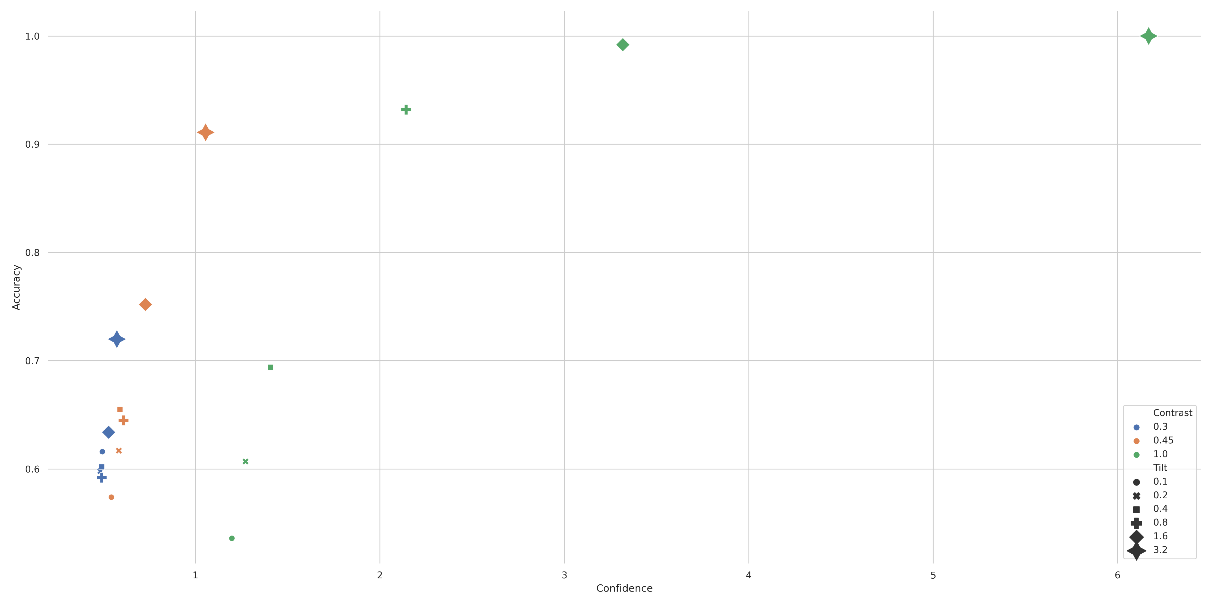
VGG16 Results *Multiple Dissociations*

Slide 17
Observations Thus Far
Tilt drives accuracy and contrast drives confidence
Transferring learning from generalized object recognition networks results in a confidence/accuracy dissociation
This matches empirical findings

Slide 18
Next Steps
Hypothesis: Activation may be stronger in early layers for high contrast in CIFAR10 network, regardless of accuracy
Analyze CIFAR10 Vanilla network VS Gabor Vanilla network
Look at activation level & variance of each layer for contrast/tilt combinations which showed dissociation

Slide 19
Extras

Slide 20
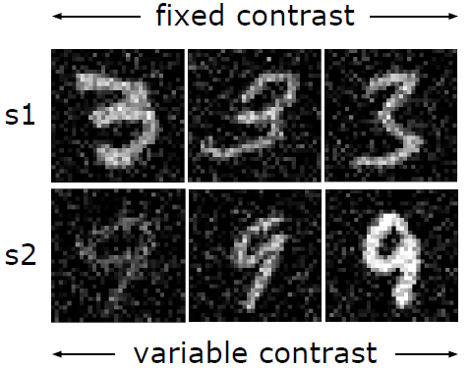
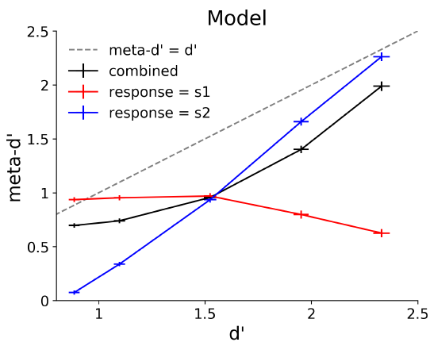
Recent Report of Same Dissociation in Neural Network
This dissociation is across fixed noise and contrast levels
Followed up with PCA analysis showing network dependence on shared variable between decision & confidence
2-choice MNIST (ie: 3 & 9)
5 contrast values used
0.05, 0.16, 0.36, 0.58 & 0.81
Webb et al., 2021 (Preprint)

